Slide 1
Raspberry Pi Bluetooth Project
By Jon

Slide 2
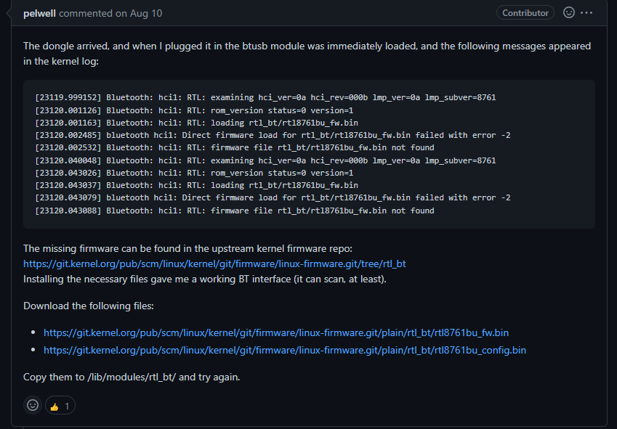
Environment set up
Raspberry pi set up
Update and reboot
Turn off the on board Bluetooth
Enable the adapter (does not work out the box for raspberry pi)

Slide 3
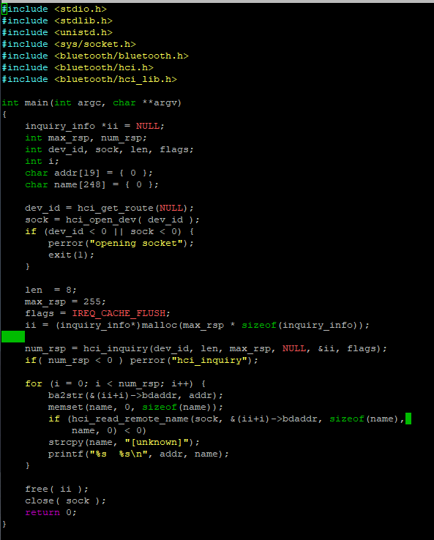
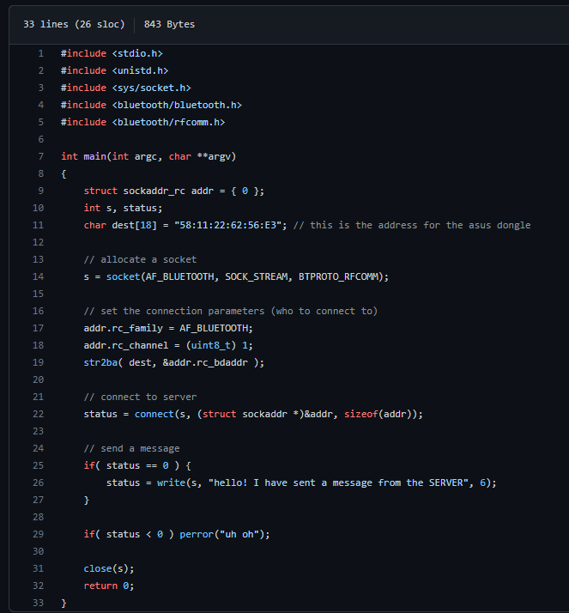
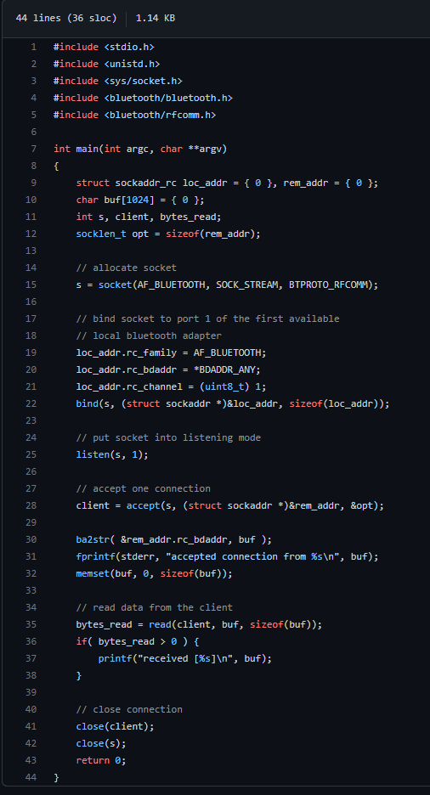
C code

Slide 4

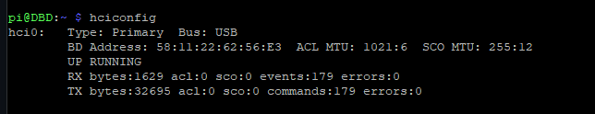
Scanning
I scanned of devices that are trying scanning to pair with other devices

Slide 5
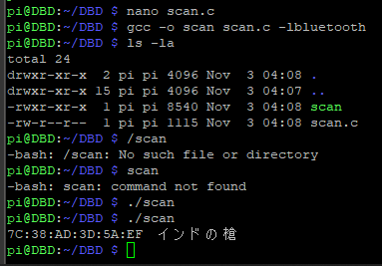
C code scanning program
Only works when a service is trying to connect to it!

Slide 6
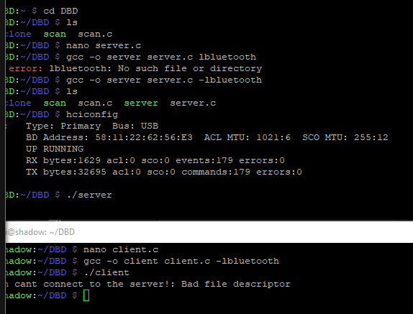
Client Server Program

Slide 7
Future Direction
Add DSP to automatically connect discovered devices without needing to pair
Send malicious packets for buffer overflow attacks
Send none sense information for DOS attack
Explore Blueborne attack avenues

